Slide 1
SE 577 Software Architecture UML Diagrams for Architectures

Slide 2
UML Component Diagrams
A component represents a modular part of a system.
Component diagrams are used to model software as group of components connected to each other through well-defined interfaces.
Component diagrams help decompose systems and represent their structural architecture from a logical perspective.
A component is represented using a box with the keyword <<component>> and optional component icon on the top right corner.

Slide 3
UML Component Diagrams (cont’d)
Components can be modeled using an external black-box or internal white-box approach.
Black-box approach hides the component’s internal structure.
Components interact with each other only through identified interfaces.
White-box approach shows the component’s internal structure (e.g., realizing classifiers).
White-box view of ComponentA
Black-box view of ComponentB

Slide 4
UML Component Diagrams (cont’d)
Component interfaces are classified as provided or required interfaces.
Provided interfaces are used by other external components to interact with the component providing the services.
Required interfaces are those the components need to carry out their functions.

Slide 5
UML Component Diagram (cont’d)
UML relationships applied to components
UML Dependency
Dependency without specifying interfaces!
Dependency between required and provided interfaces is equivalent to the assembly connector.
These are equivalent!
Notice these
are interfaces
Notice this is a class
ComponentA
InterfaceB
ComponentA
InterfaceB

Slide 6
UML Component Diagram (cont’d)
Two more important concepts used in component diagrams are:
Ports
Abstraction used to model access points for allowing the external environment to access the component’s services and for allowing components to interact with their external environment.
Modeled using a small square at the boundary of the component box.
Ports can be named, e.g., port names below are Port 1 and Port 2.
Delegation connectors
Used to model the link between the external provided interfaces of a component to the realization of those interfaces internally within the component.
Similarly, delegation connectors model the link between internally required interfaces to ports requiring the interface from external components.
Modeled using a directed arrow with the stereotype <<delegate>>
White-box view of ComponentA shows how the external behavior is realized internally
Port
Delegate connector
Port

Slide 7
Component Diagram Example
What does a component diagram look like for a system with the following desired properties:
A data collection system equipped with:
Sensors
Video capture capabilities
Automatic collection at specific times of the day.
Collection schedules need to be provided to the system.
The system must make available the data collected.
Both sensor and video data.
Also, health data about the system
Events, problems, etc.

Slide 8
Component Diagram Example (cont’d)
Provides collection and health data
Requires
collection
schedule
Video capture functions
Sensor functions

Slide 9
UML 2.3 Enhancing Features
Stereotypes
Mechanism for extending UML by adding information that gives existing UML elements (both classifiers and relationships) a different meaning, therefore creating a semantically different element for modeling application-specific concepts.
Modeled as existing UML elements with the <<stereotype>> mechanism.

Slide 10
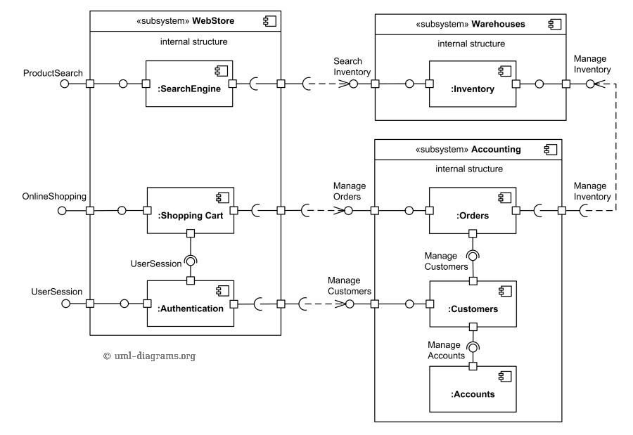
Sample Component Diagram

Slide 11
UML Deployment Diagrams
Deployment diagrams are used to model the physical realization of software systems.
They provide the means to visualize and evaluate the environment in which software executes.
They model nodes and the interfaces between them.
A node is a computational resource that host software artifacts for execution.
A node is a represented by a named cube.
Deployment diagrams also include artifact and components and depict how all of these work together from a system deployment perspective.
UML relationships applied to the these classifier is presented below.

Slide 12
UML Deployment Diagrams (cont’d)
There is a communication path between Nodes A and B
ArtifactA is deployed on NodeB
ArtifactA embodies ComponentA
ArtifactA depends on ArtifactB

Slide 13
UML Deployment Diagrams (cont’d)
A UML artifact is used to model physical units of information that form part of the software system, such as binary executable files, configuration files, scripts, .jar files, .dll, etc.
An artifact is represented using a rectangle with the keyword <<artifact>>

Slide 14
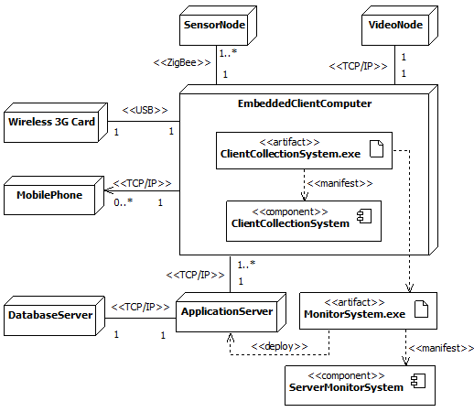
Example of UML Deployment Diagram

Slide 16
Order Processing System Example
Consider the following simple example of an Order Processing System*:
New orders are received and loaded into a database.
Each order must be validated against an existing customer system to check the customer information and that valid payment options exist.
Once validated, the order data is simply stored in the order processing database, and an email is generated to the customer to inform them that their order is being processed.
If the order is not validated, log the error.
What does your architecture diagram look like?
* Example from Ian Gorton, Essential Software Architecture, Springer-Verlag

Slide 17
Order Processing Components
Application components are:
OrderInput: responsible for accessing the new orders database, encapsulating the order processing logic, and writing to the queue.
Validate: encapsulates the responsibility of interacting with the customer system to carry out validation and writing to the error logs if an order is invalid.
Store: responsibility of interacting with the order system to store the order data.
SendEmail: removes a message from the queue, formats an email message and sends it via an email server. It encapsulates all knowledge of the email format and email server access.

Slide 18
Order Processing System
read
Write
Order
OrderQ
New
Orders
OrderInput
Get
Order
Check
Order
Write
Order
SendEmail
Validate
Store
Error
Log
Customer
System
Order
System
Email
Server
Figure Key
Existing Component
New
Component
Dependency
Database
Persistent Queue

Slide 19
Component Diagram

Slide 20
Component Interfaces

Slide 21
Component Interfaces (cont’d)

Slide 22
Component Decomposition

Slide 23
Class Diagram

Slide 24
Sequence Diagram

Slide 25
Deployment Diagram

Slide 27
Process View Example
Consider a trading system, where trading decisions are based on information collected from three different sources: a stock ticker, an index watcher, and a CNNNewsFeed.
Information from the stock ticker and the index watcher are first analyzed and then forwarded to the trading manager via an alert manager.
The CNNNewsFeed communicates directly with the Trading manager.

Slide 28
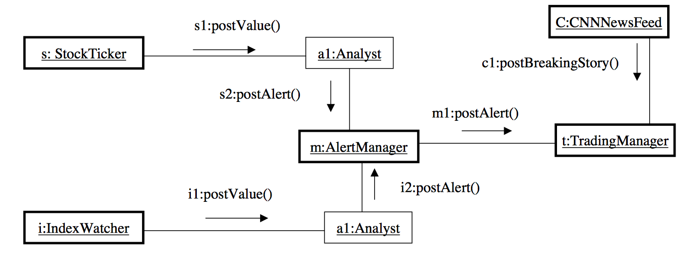
Process View Example (cont’d)

